Slide 1


Calculus and applications
MTH10012
Week 5

Slide 2
Introduction
Week 4
Standard limits comparing “speeds” and using the substitution technique
Sequences, limits (convergent, divergent, irregular), limit laws, standard limits
Week 5
MODULE 3
The sandwich theorem for sequences
The relation between sequences and continuous functions
MODULE 4
Definition of derivative
Standard derivatives
Rules for differentiation

Slide 3
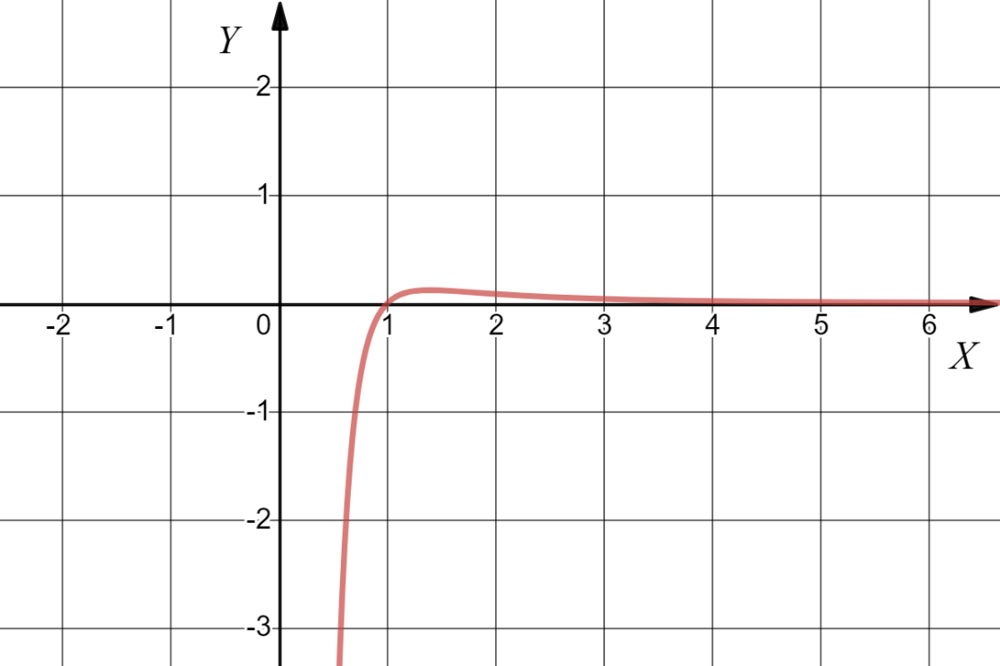
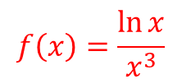

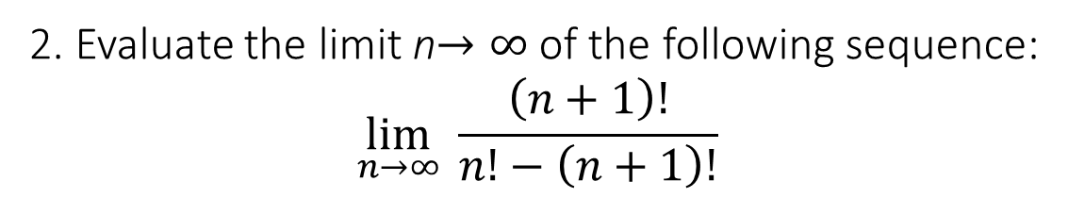
Test your knowledge
1. Can you guess, in general terms, what is the formula that describes the function represented by this graph?
$$f\left(x\right)=\frac{\ln{x}}{x^{3}}$$
2. Evaluate the limit n$→∞$ of the following sequence:
$$\lim_{n→∞}{ \frac{\left(n+1\right)!}{n!−\left(n+1\right)!}}$$
$$=−1$$

Slide 4
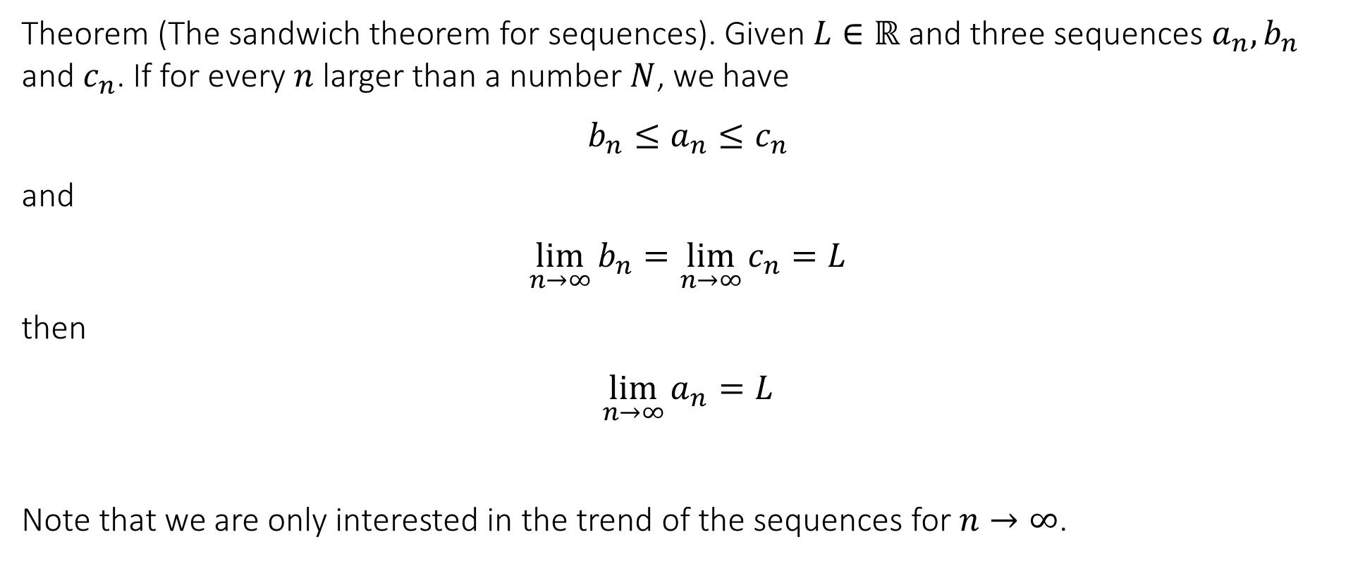
3.5 The sandwich theorem for sequences
Theorem (The sandwich theorem for sequences). Given $L∈ℝ$ and three sequences $a_{n}, b_{n}$ and $c_{n}$. If for every $n$ larger than a number $N$, we have
$$b_{n}≤a_{n}≤c_{n}$$
and
$$\lim_{n→∞}{b_{n}}=\lim_{n→∞}{c_{n}}=L$$
then
$$\lim_{n→∞}{a_{n}}=L$$
Note that we are only interested in the trend of the sequences for $n→∞$.

Slide 5
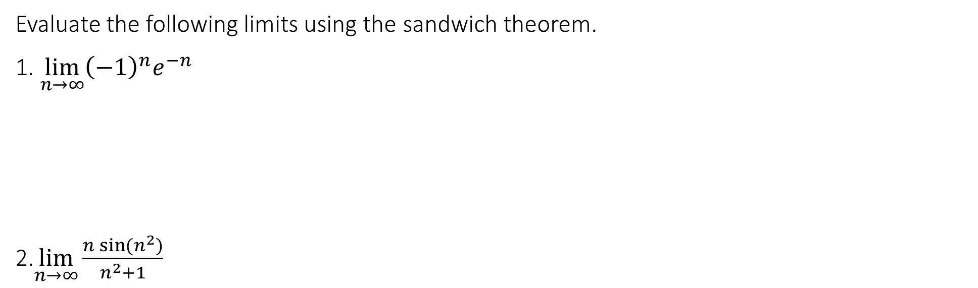
3.5 The sandwich theorem for sequences
Evaluate the following limits using the sandwich theorem.
1. $\lim_{n→∞}{{\left(−1\right)}^{n}e^{−n}}$
2.$\lim_{n→∞}{\frac{n\sin{(n^{2})}}{n^{2}+1}}$

Slide 6
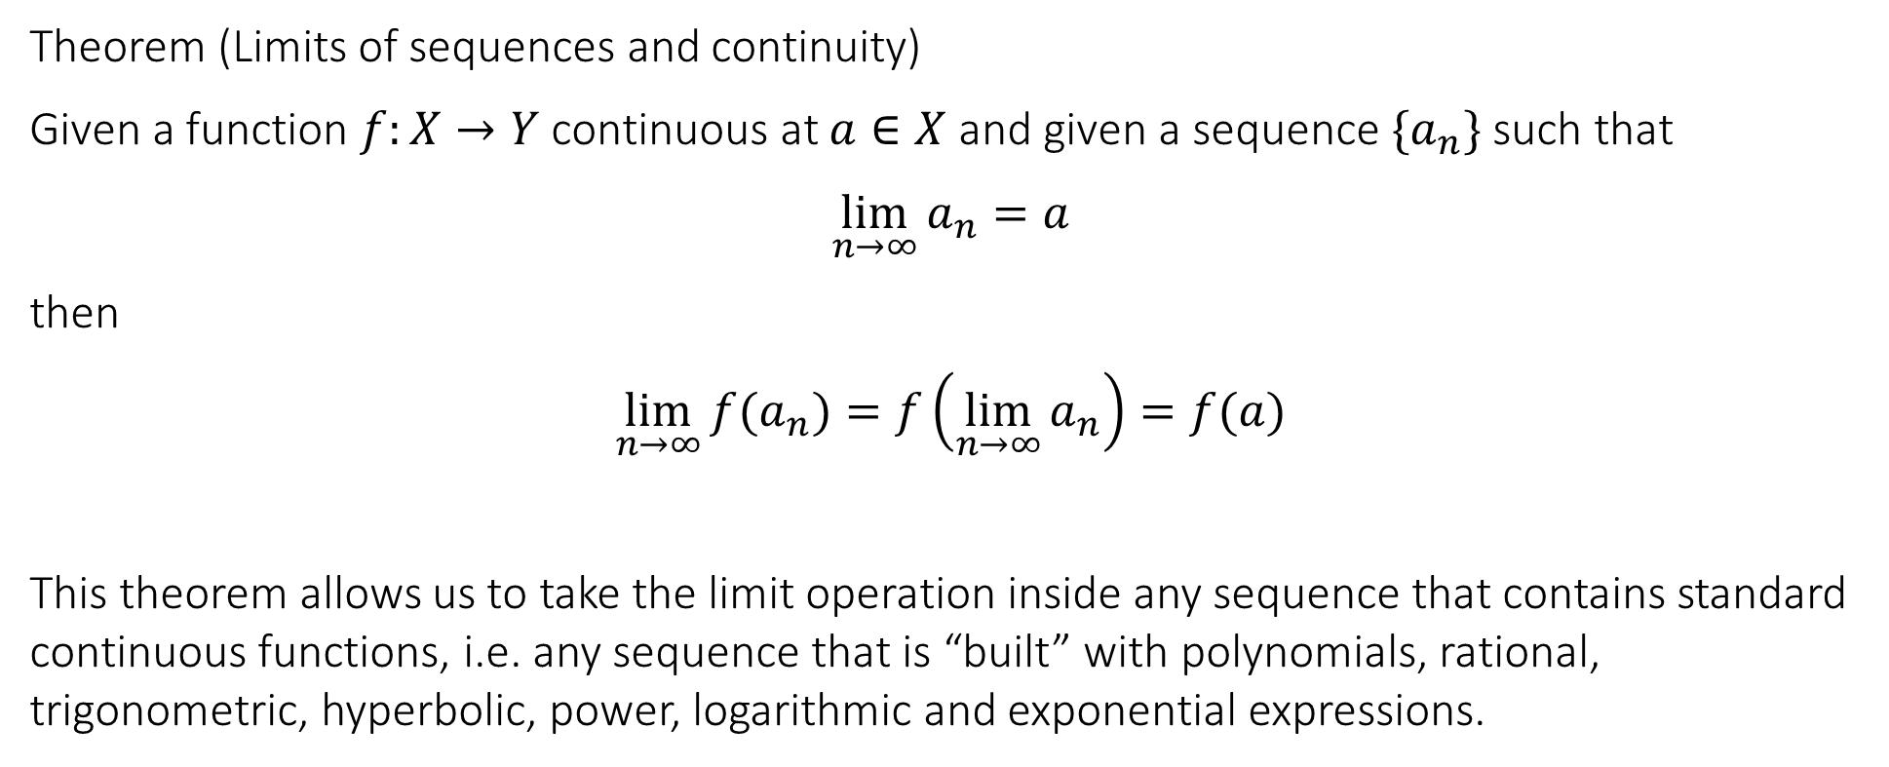
3.6 The relation between sequences and continuous functions
Theorem (Limits of sequences and continuity)
Given a function $f:X→Y$ continuous at $a∈X$ and given a sequence $\{a_{n}\}$ such that
$$\lim_{n→∞}{a_{n}}=a$$
then
$$\lim_{n→∞}{f(a_{n})}=f\left(\lim_{n→∞}{a_{n}}\right)=f(a)$$
This theorem allows us to take the limit operation inside any sequence that contains standard continuous functions, i.e. any sequence that is “built” with polynomials, rational, trigonometric, hyperbolic, power, logarithmic and exponential expressions.

Slide 7

3.6 The relation between sequences and continuous functions
Evaluate the following limits.
1. $\lim_{n→∞}{\arcsin{(\sqrt{1−e^{−n}})}}$
2. $\lim_{n→∞}\left(\arctan\left(1+\frac{2}{n^{2}}\right)−\exp\left(\frac{\cos{n}}{n}\right)\right)$

Slide 8
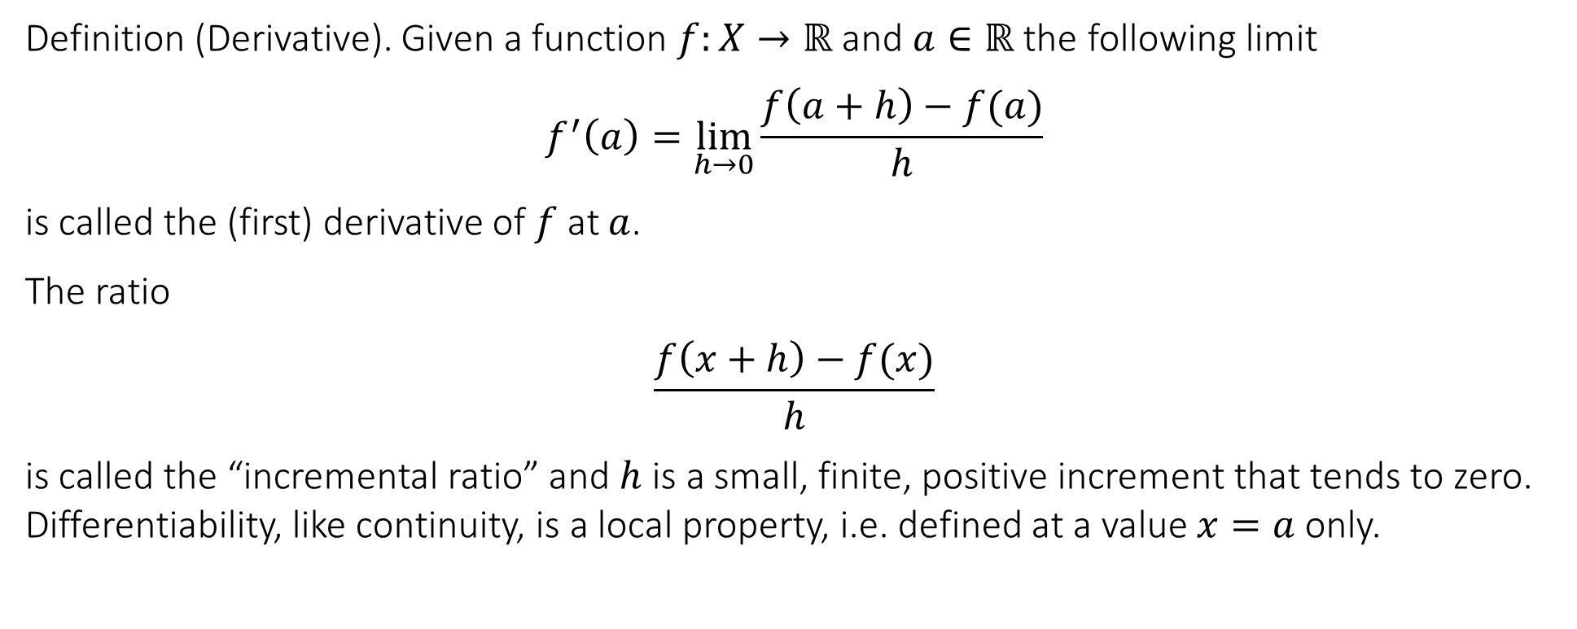
4.1 Definition and interpretation of the derivative
MODULE 4
https://www.youtube.com/watch?v=_Idra8rVS1I&t=320s
https://www.youtube.com/watch?v=ObPg3ki9GOI
Definition (Derivative). Given a function $f:X→ℝ$ and $a∈ℝ$ the following limit
$$f^{′}\left(a\right)=\lim_{h→0}{\frac{f\left(a+h\right)−f(a)}{h}}$$
is called the (first) derivative of $f$ at $a$.
The ratio
$$\frac{f\left(x+h\right)−f(x)}{h}$$
is called the “incremental ratio” and $h$ is a small, finite, positive increment that tends to zero. Differentiability, like continuity, is a local property, i.e. defined at a value $x=a$ only.

Slide 9
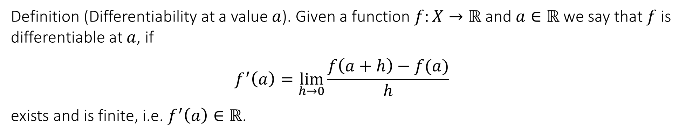
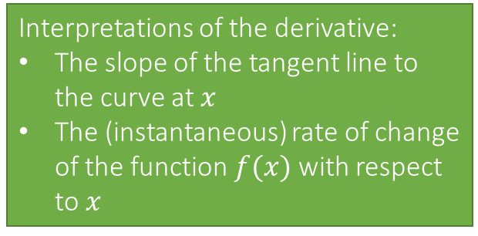
4.1 Definition and interpretation of the derivative
Definition (Differentiability at a value $a$). Given a function $f:X→ℝ$ and $a∈ℝ$ we say that $f$ is differentiable at $a$, if
$$f^{′}\left(a\right)=\lim_{h→0}{\frac{f\left(a+h\right)−f(a)}{h}}$$
exists and is finite, i.e. $f^{′}\left(a\right)∈ℝ$.
Interpretations of the derivative:
The slope of the tangent line to the curve at $x$
The (instantaneous) rate of change of the function $f(x)$ with respect to $x$
https://www.geogebra.org/m/p7qqucf9#:~:text=Author%3A%20Simona%20Riva,represents%20the%20independent%20variable%20increment.

Slide 10
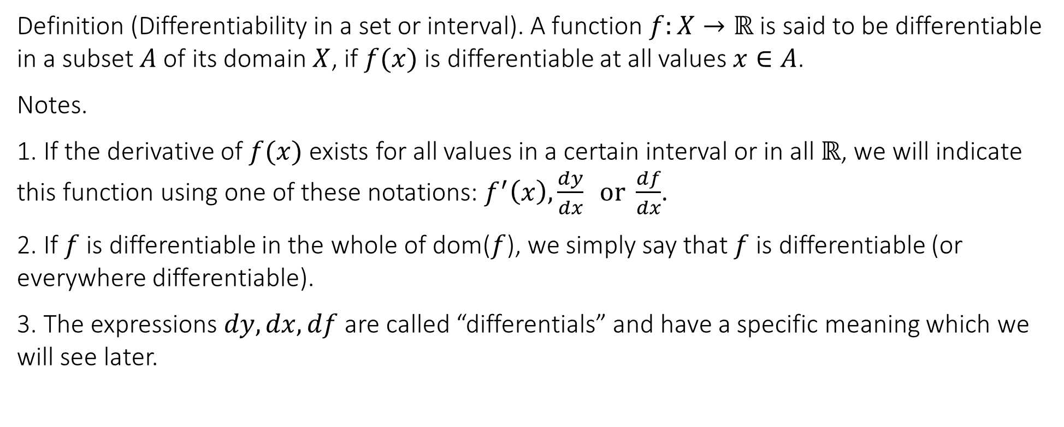
4.1 Definition and interpretation of the derivative
Definition (Differentiability in a set or interval). A function $f:X→ℝ$ is said to be differentiable in a subset $A$ of its domain $X$, if $f(x)$ is differentiable at all values $x∈A$.
Notes.
1. If the derivative of $f(x)$ exists for all values in a certain interval or in all $ℝ$, we will indicate this function using one of these notations: $f^{′}\left(x\right),\frac{dy}{dx} or \frac{df}{dx}$.
2. If $f$ is differentiable in the whole of dom($f$), we simply say that $f$ is differentiable (or everywhere differentiable).
3. The expressions $dy,dx,df$ are called “differentials” and have a specific meaning which we will see later.

Slide 11
4.2 Standard derivatives
These are the basic derivatives, the “building blocks” of any expression that bears some interest for engineering or science.
Using the definition or as is commonly named, from “first principles”, we will calculate some of these derivatives.

Slide 12
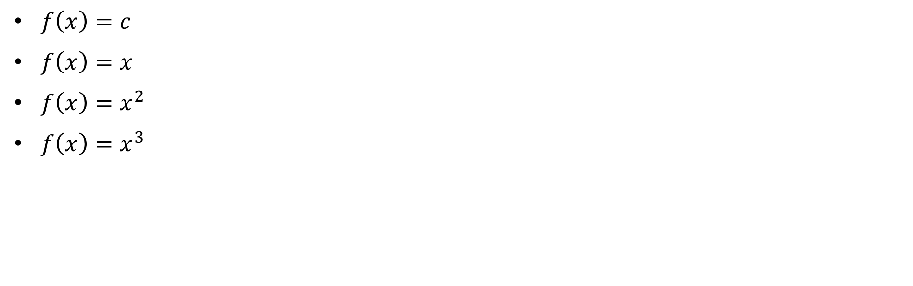
4.2 Standard derivatives
$f\left(x\right)=c$
$f\left(x\right)=x$
$f\left(x\right)=x^{2}$
$f\left(x\right)=x^{3}$

Slide 13
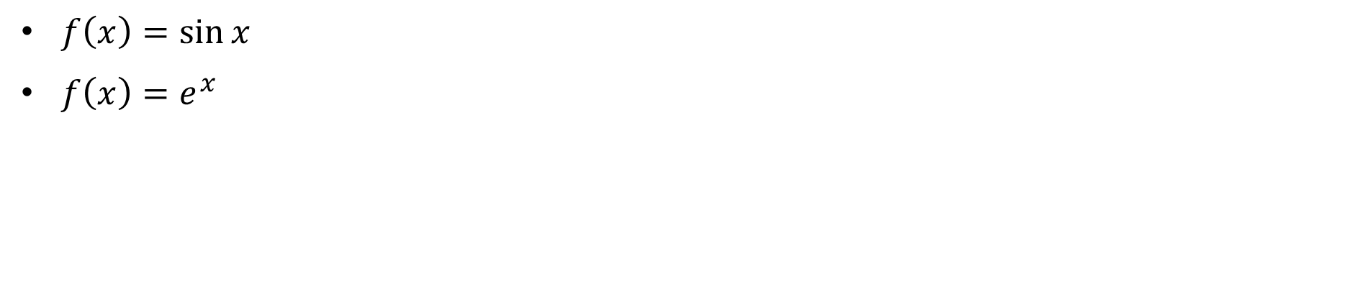
4.2 Standard derivatives
$f\left(x\right)=\sin{x}$
$f\left(x\right)=e^{x}$

Slide 14
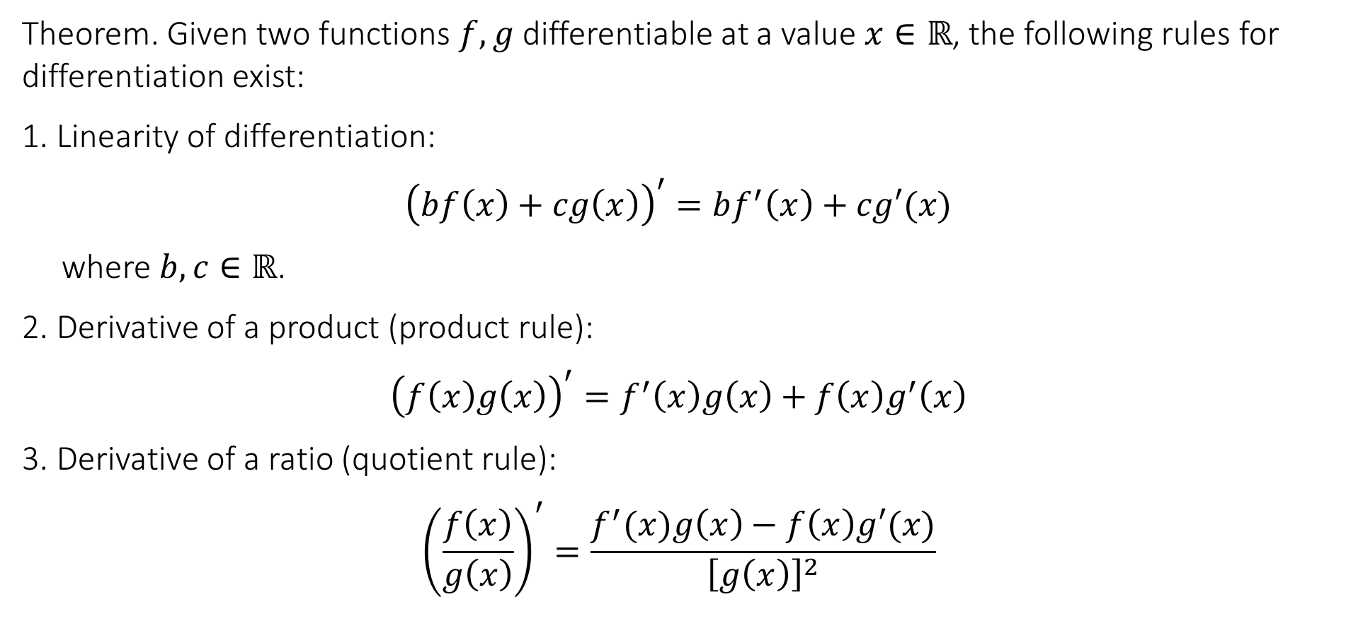
4.3 Rules for differentiation
Theorem. Given two functions $f,g$ differentiable at a value $x∈ℝ$, the following rules for differentiation exist:
1. Linearity of differentiation:
$${\left(bf\left(x\right)+cg\left(x\right)\right)}^{′}=bf^{′}\left(x\right)+cg′(x)$$
where $b,c∈ℝ$.
2. Derivative of a product (product rule):
$${\left(f\left(x\right)g\left(x\right)\right)}^{′}=f^{′}\left(x\right)g\left(x\right)+f\left(x\right)g^{′}\left(x\right)$$
3. Derivative of a ratio (quotient rule):
$${\left(\frac{f\left(x\right)}{g\left(x\right)}\right)}^{′}=\frac{f^{′}(x)g\left(x\right)−f\left(x\right)g′(x)}{{\left[g\left(x\right)\right]}^{2}}$$

Slide 15
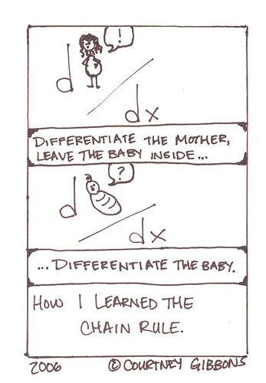
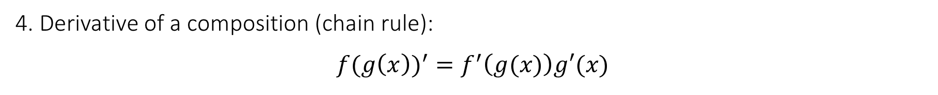
4.3 Rules for differentiation
4. Derivative of a composition (chain rule):
$${f(g\left(x\right))}^{′}=f^{′}\left(g(x)\right)g′(x)$$

Slide 16
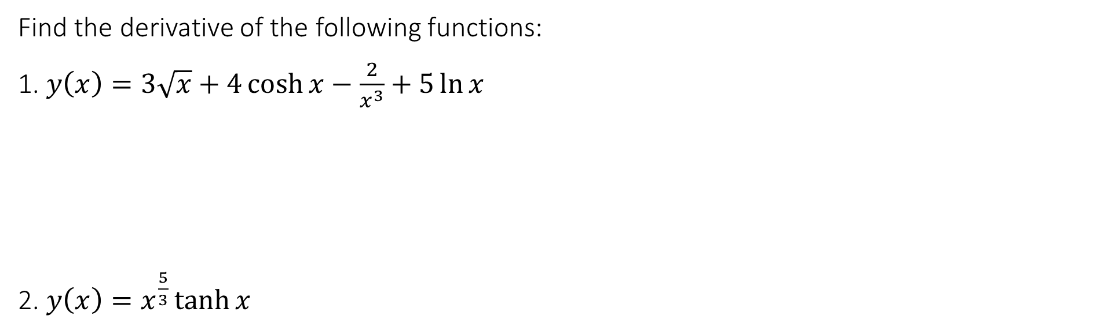
4.3 Rules for differentiation
Find the derivative of the following functions:
1. $y\left(x\right)=3\sqrt{x}+4\cosh{x}−\frac{2}{x^{3}}+5\ln{x}$
2. $y\left(x\right)=x^{\frac{5}{3}}\tanh{x}$

Slide 17
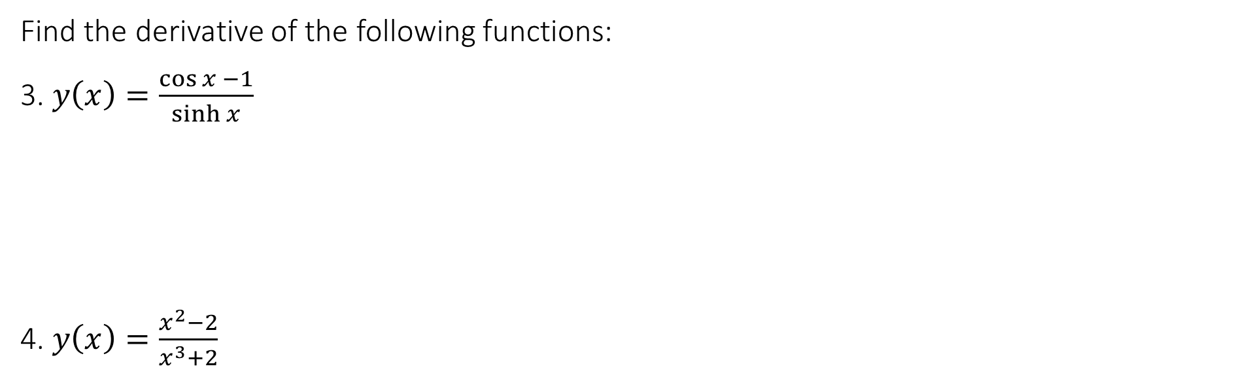
4.3 Rules for differentiation
Find the derivative of the following functions:
3. $y\left(x\right)=\frac{\cos{x} −1}{\sinh{x}}$
4. $y\left(x\right)=\frac{x^{2}−2}{x^{3}+2}$

Slide 18
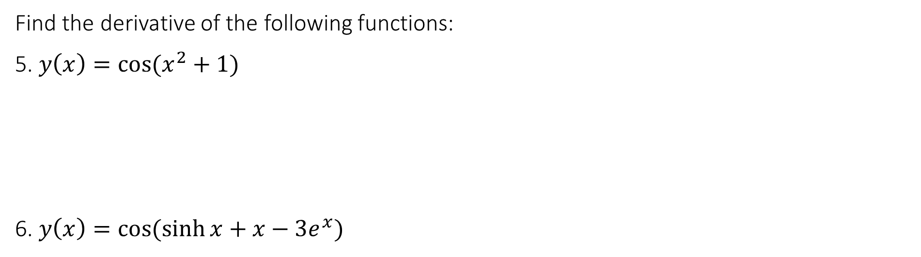
4.3 Rules for differentiation
Find the derivative of the following functions:
5. $y\left(x\right)=\cos{(x^{2}+1)}$
6. $y\left(x\right)=\cos{(\sinh{x}+x−3e^{x})}$

Slide 19
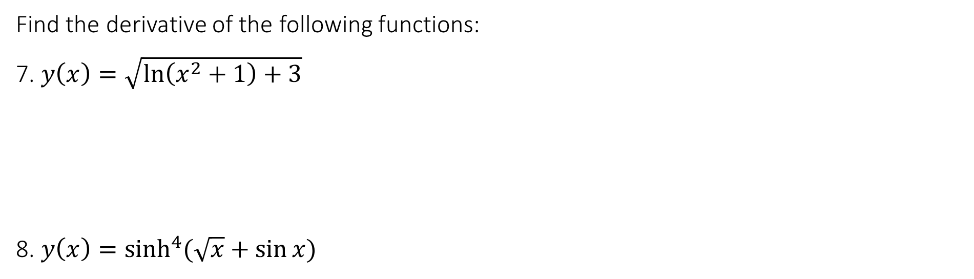
4.3 Rules for differentiation
Find the derivative of the following functions:
7. $y\left(x\right)=\sqrt{\ln\left(x^{2}+1\right)+3}$
8. $y\left(x\right)=\sinh^{4}(\sqrt{x}+\sin{x)}$

Slide 20
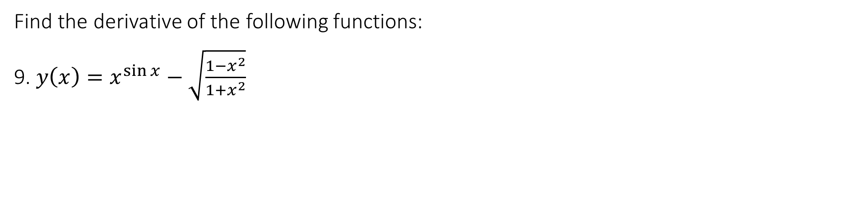
4.3 Rules for differentiation
Find the derivative of the following functions:
9. $y\left(x\right)=x^{\sin{x}}−\sqrt{\frac{1−x^{2}}{1+x^{2}}}$

Slide 21
End of Lecture

